Slide 1
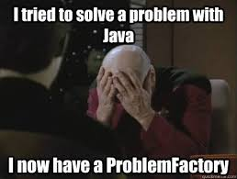
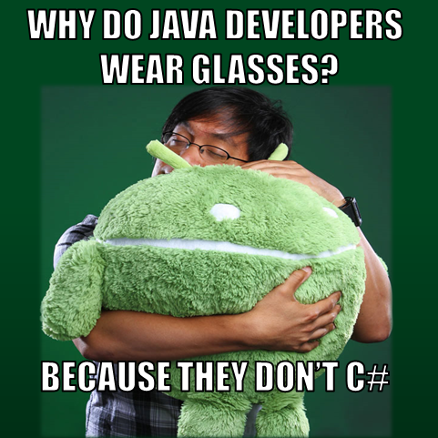
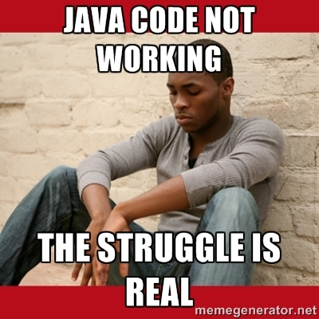
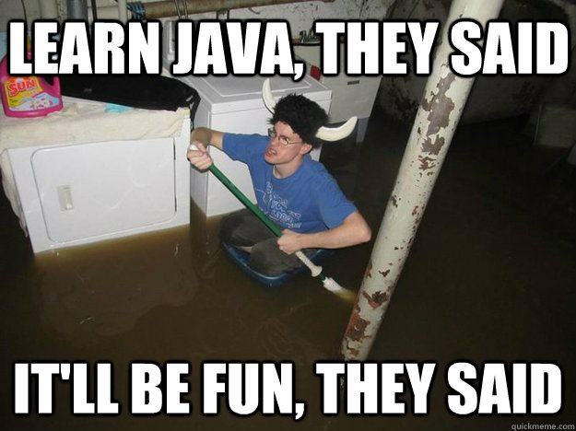
Java

Slide 2
Attendance
Please fill this form out:
https://tinyurl.com/y483ysj6

Slide 3
All the Primitives in Java
Byte
Short
Int
Long
Float
Double
Char
Boolean
Notes:
(Here are examples for using each primitive in java)

Slide 4
The If-else Statement (Layout)
If (Statement)
{
//Type something here
}
else
{
//Type something here
}
Notes:
(Here are examples for using each primitive in java)

Slide 5
Arrays
Declaring an Array (All the ways possible)
int[] Arr = new int[10]
Arr = new int[10]
int[] Arr

Slide 6
Loops
For loops
While loops
Difference between both types of loops
Which one is better?
Consider the example

Slide 7
Objects
Class Point{
int x; int y;
}
point(int x, int y)
{
this.x = x; this.y = y;
}
Notes:
Explain Code & talk about

Slide 9
Questions???

